Slide 1
Love is a fantastic journey,
which often starts off as a fantasy journey.
Notes:
Luck is, if time does not count!

Slide 2
Love is a space mission,
after the rocket start you arrive at so far unknown galaxies and it goes beyond all your known experiences.
Notes:
Luck is, if time does not count!

Slide 3
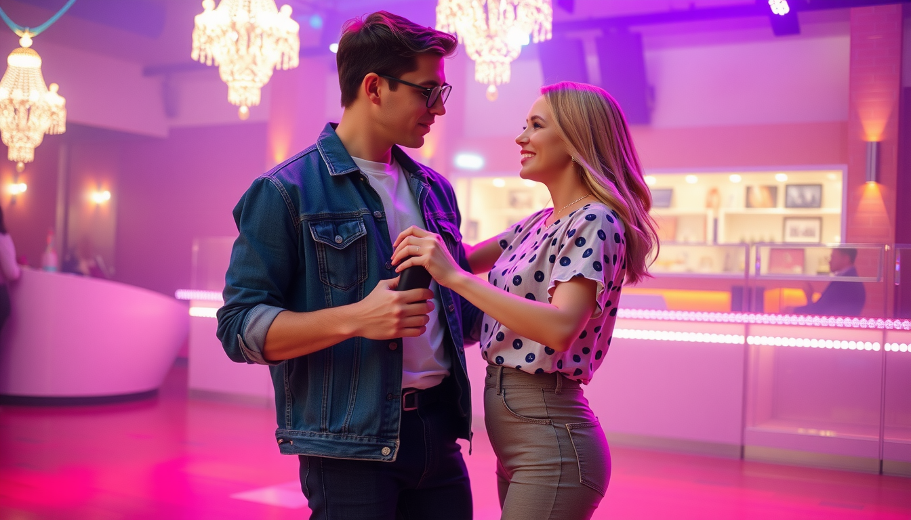
Notes:
Promt for picture at https://www.midjourneyfree.ai/user/image-generator:
You are a fashion designer. You are expert in retro-design clothes dated back to a certain time in the past. Your particular expertise are clothes from the 1980ties. Create a photographic picture. It shows two teenagers in a dancing hall. The boyfriend and his girlfriend have their first rendezvous. Show them in the typical fashion of clothes in 1985.

Slide 4
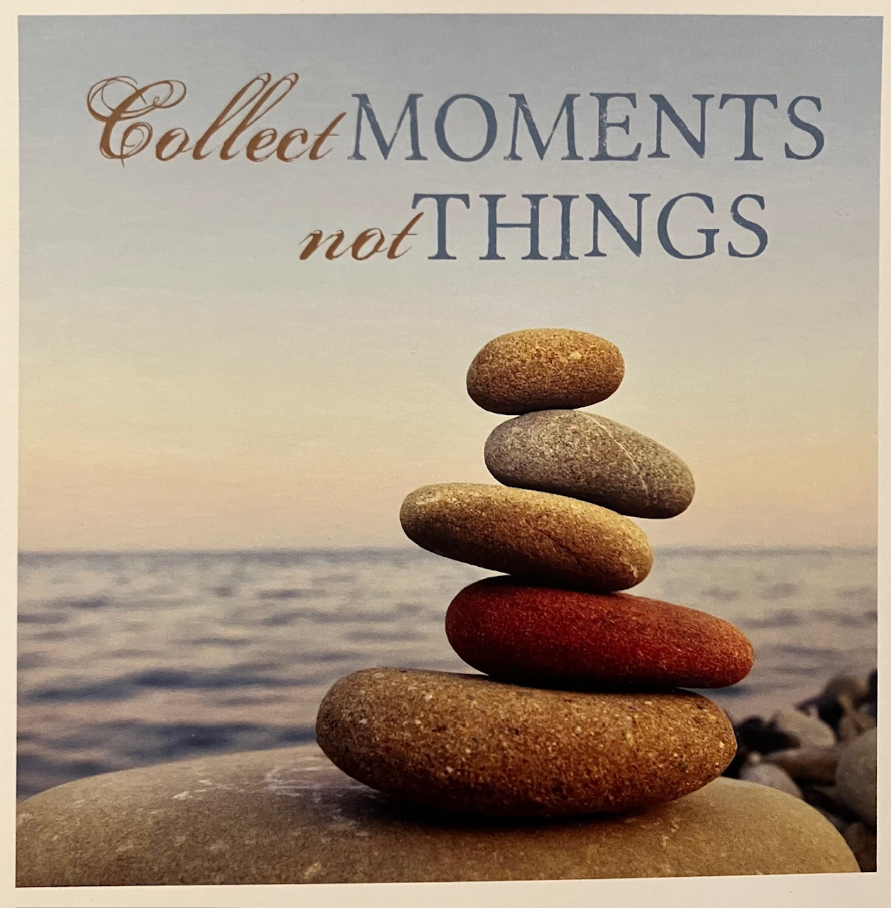

Slide 5
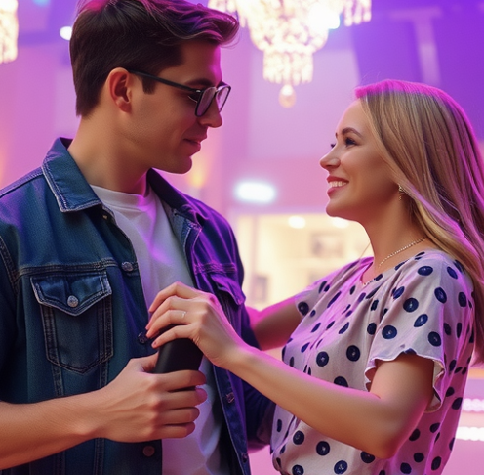
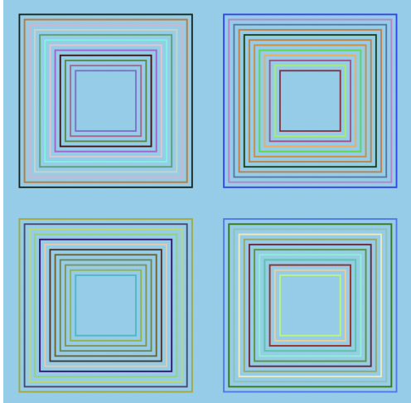
Do IT Yourself NFT

Slide 6
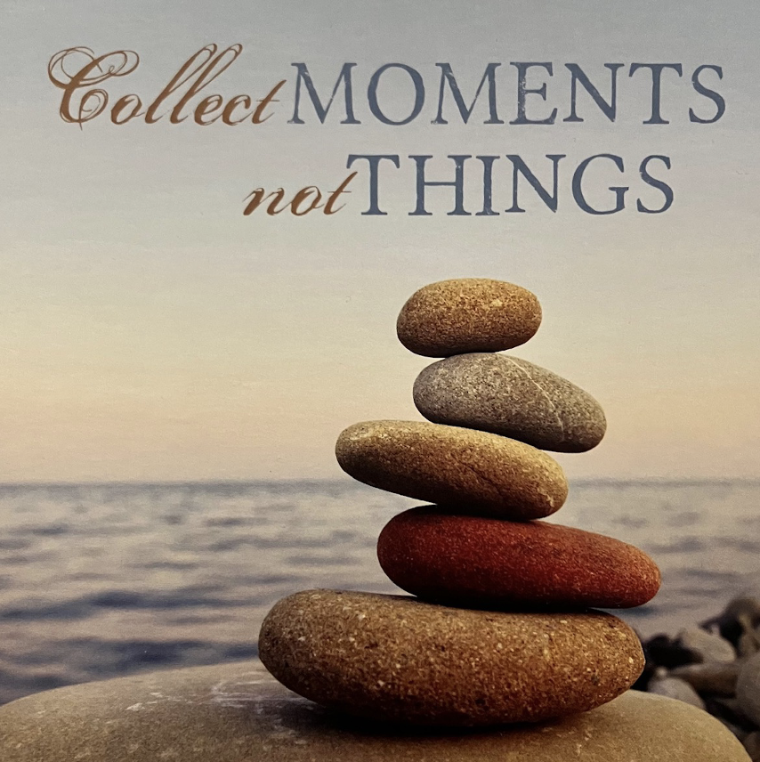
Frame IT! Preserve your moment
Poem, Song,
Music,…
Words,
Letter, Metaphor, Symbol,…

Slide 7
Fix IT! Unique by Hash over frame colors
Poem, Song,
Music,…
Words, Letter,
Metaphor, Symbol,…

Slide 8
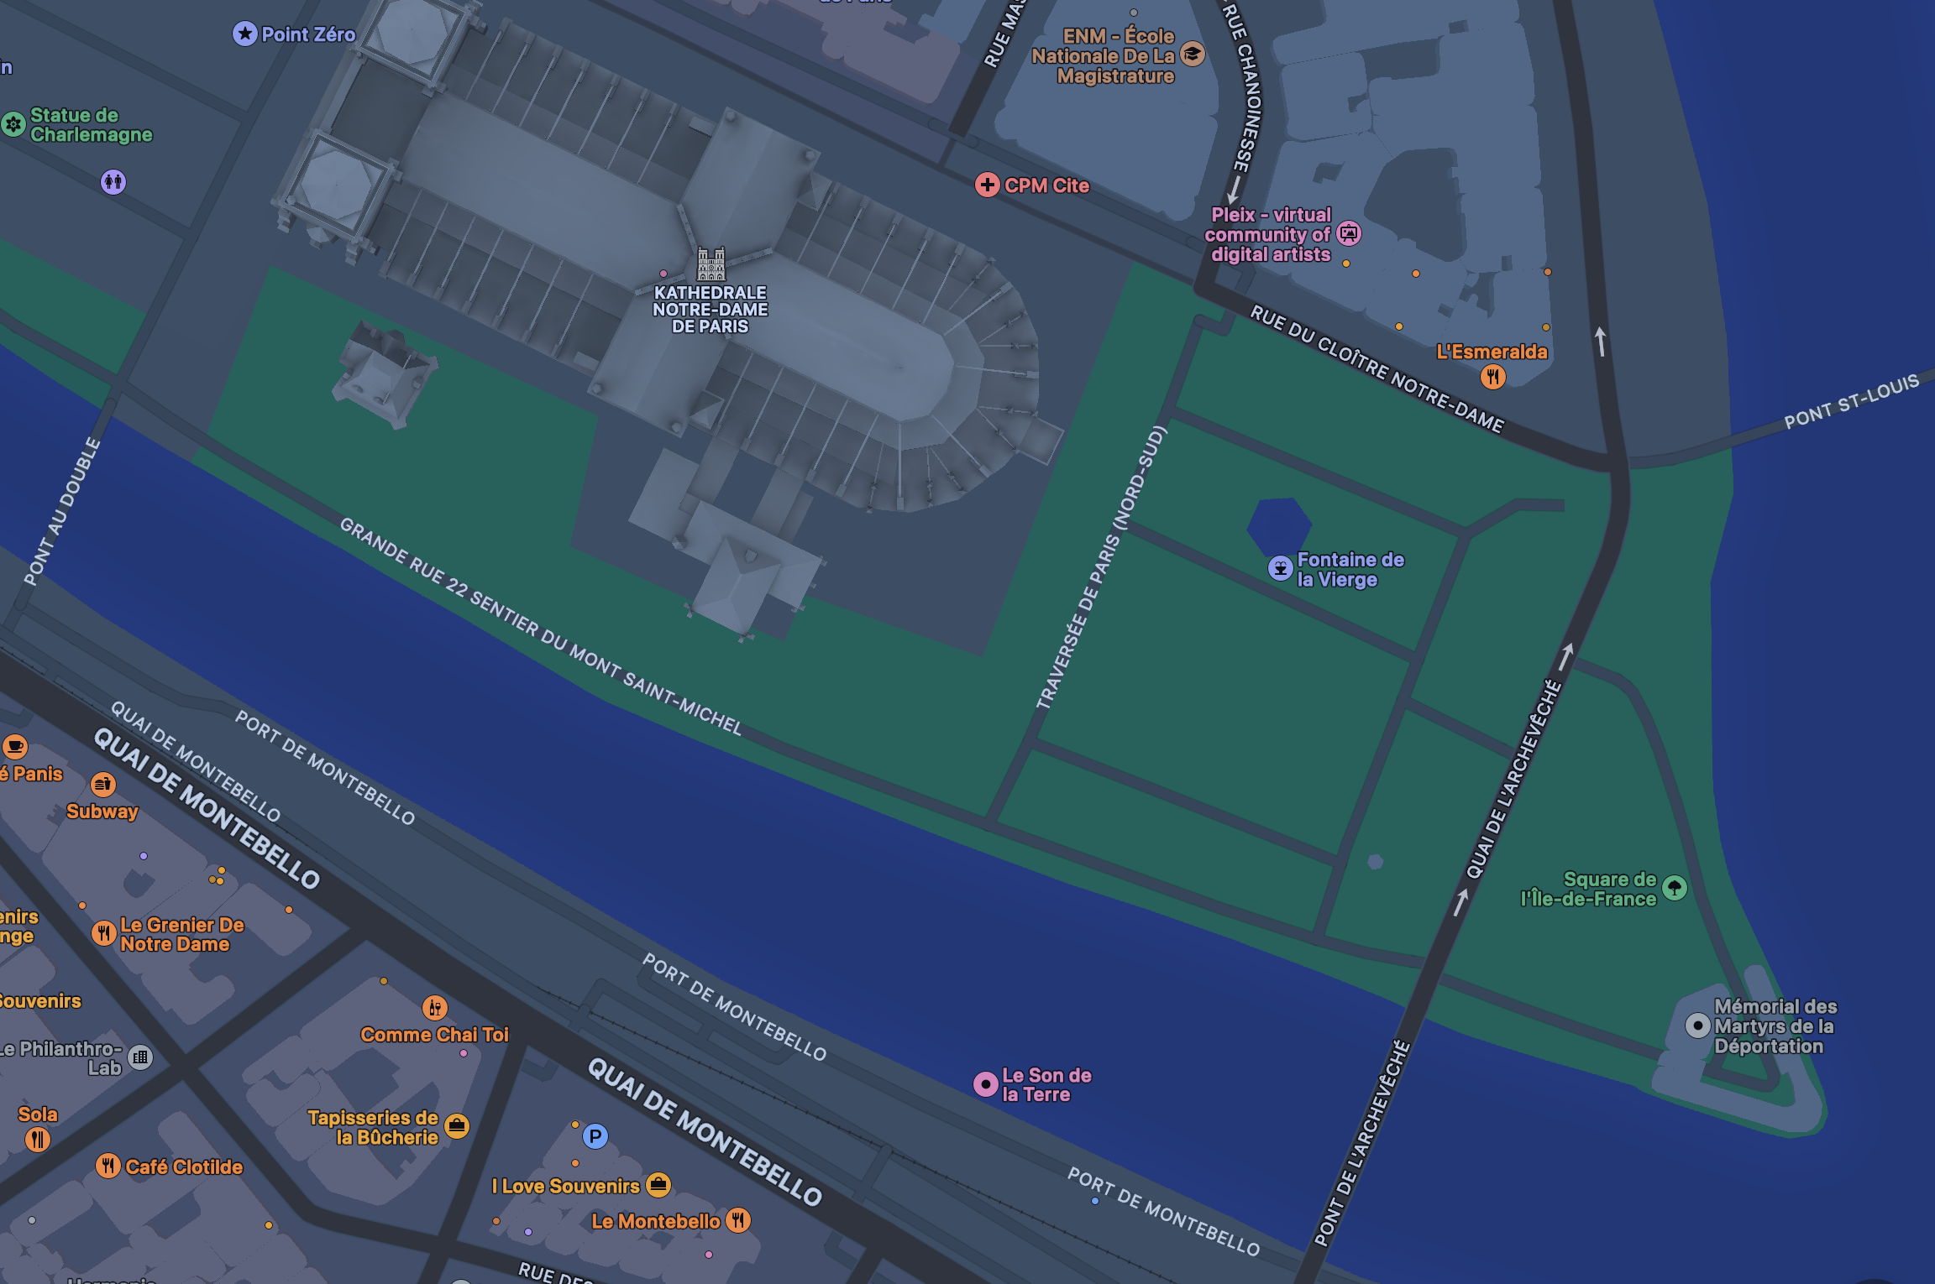
Lock IT! Place hash (frame_hash + GPS)
Poem,Song,Music, …
Letter, Sym-bol, …

